Slide 1



Keras
Very flexible
or
Need some effort to learn
Easy to learn and use
Interface of TensorFlow or Theano
(still have some flexibility)
You can modify it if you can write TensorFlow or Theano
keras
Notes:
適合初學者
台大上課
太過 ＯＰ
Toolkit

Slide 2
Keras
François Chollet is the author of Keras.
He currently works for Google as a deep learning engineer and researcher.
Keras means horn in Greek
Documentation: http://keras.io/
Example: https://github.com/fchollet/keras/tree/master/examples
Notes:
角；觸角，觸鬚牛角
而謹慎的佩涅洛佩則説道：“尊敬的客人，夢幻是很難解釋清楚的，并不是所有的夢景都會變爲現實。來去無蹤的夢神一般穿行於兩座大門，一座由牛角制成，一座由象牙雕成。穿過象牙大門來到人的夢鄉的夢神，只會欺人，所現所説不會成爲現實。而通過牛角大門進入的夢神，卻給任何一個凡人帶真實可信的訊息。但是，我的夢境不是後一位夢神提供的，雖然那里情節讓我心情舒暢。

Slide 3
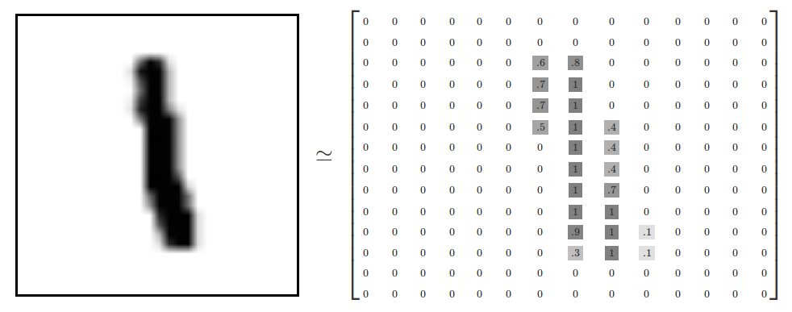
“Hello world”
Handwriting Digit Recognition
Machine
“1”
28 x 28
MNIST Data: http://yann.lecun.com/exdb/mnist/
Keras provides data sets loading function: http://keras.io/datasets/

Slide 4
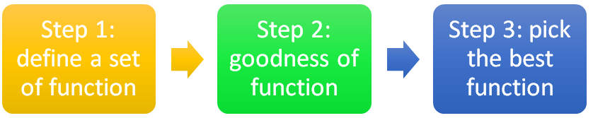
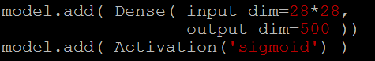
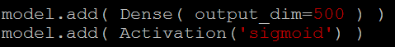
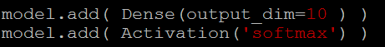
Keras
28x28
……
500
……
softplus, softsign, relu, tanh, linear
500
……
Softmax
y₁
y₂
y₁₀
……
Notes:
https://en.wikipedia.org/wiki/Activation_function
Theno: Universite de Montr ´ eal
Yoshua Bengio

Slide 5
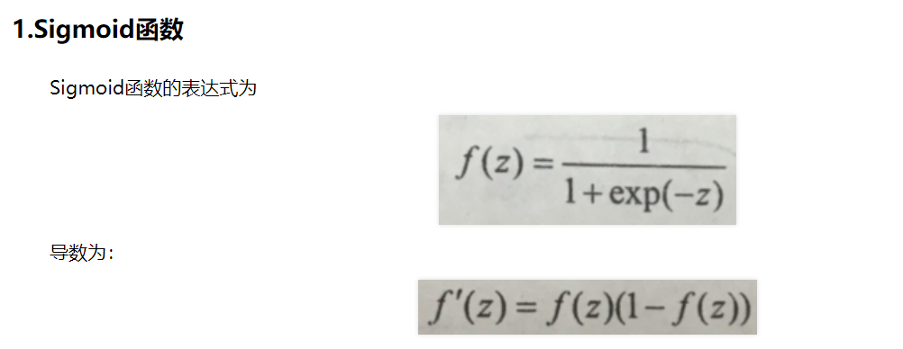

Slide 6
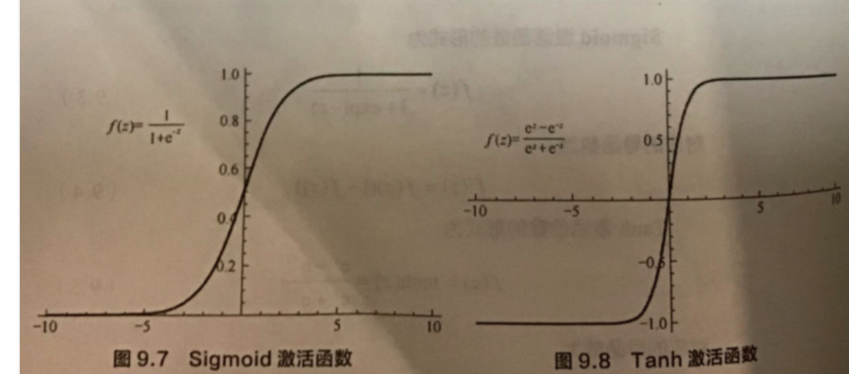

Slide 7
Vanishing Gradient Problem
……
y₁
……
y₂
……
……
……
……
……
……
y_{M}
Smaller gradients
Larger gradients
Learn very slow
Learn very fast
Almost random
Already converge
based on random!?
Notes:
The problem of gradient vanish is very hard to explain ……………….!!!!!!!!!!!!!!!!!!!!!!!!!!!!!!!!!
石頭湯裡的石頭
See Gradient flow in recurrent nets: the difficulty of learning long-term dependencies, by Sepp Hochreiter, Yoshua Bengio, Paolo Frasconi, and Jürgen Schmidhuber (2001). This paper studied recurrent neural nets, but the essential phenomenon is the same as in the feedforward networks we are studying. See also Sepp Hochreiter's earlier Diploma Thesis,Untersuchungen zu dynamischen neuronalen Netzen (1991, in German).
Stuck at a bad local minima
When deep learning is difficult in early year
Need initialization
Another point of view
Definition of gradient

Slide 8
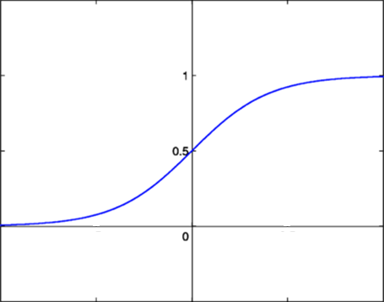
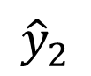
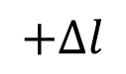
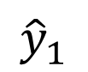
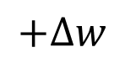
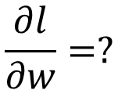
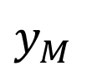
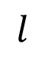
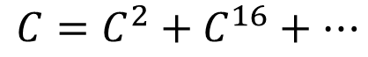
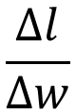
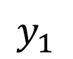
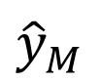
Vanishing Gradient Problem
Smaller gradients
……
$$y_{1}$$
$${\hat{y}}_{1}$$
Small output
……
$$y_{2}$$
$${\hat{y}}_{2}$$
……
……
……
……
……
$$l$$
……
$$+∆l$$
……
$$y_{M}$$
$${\hat{y}}_{M}$$
Large input
$$+∆w$$
Intuitive way to compute the derivatives …
$$\frac{∂l}{∂w}=?$$
$$\frac{∆l}{∆w}$$

Slide 10
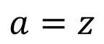
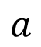
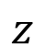
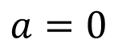
ReLU
$$a$$
$$a=z$$
$$a=0$$
$$z$$
0
0
0
0

Slide 11
ReLU
$$a$$
$$a=z$$
A Thinner linear network
$$a=0$$
$$z$$
Do not have smaller gradients

Slide 12
RelU
Sigmoid ，tanh与ReLU 比较：
计算快
2. 相对宽的激活边界，避免梯度消失；
具有稀疏表达能力
缺点：
1.训练过程中会导致神经元死亡的问题。
2.在实际训练中，如果学习率设置较大，会导致一定比例的神经元死亡，进而参数梯度无法更新，整个训练过程失败。

Slide 13
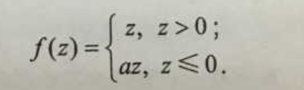
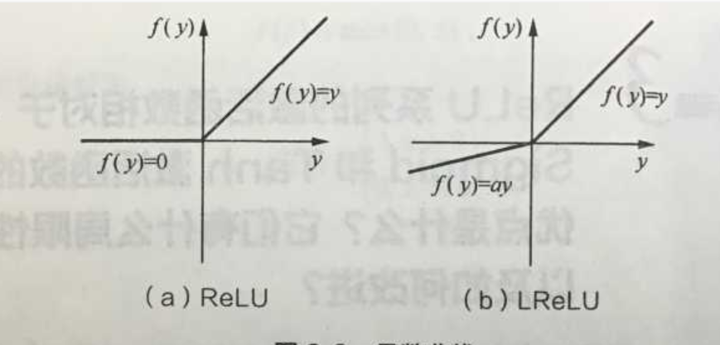
Leaky ReLU（LReLU）

Slide 14
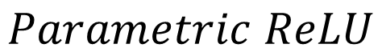
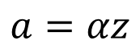
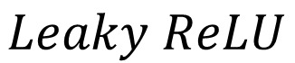
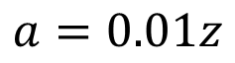
ReLU - variant
$$Leaky ReLU$$
$$Parametric ReLU$$
$$a$$
$$a$$
$$a=z$$
$$a=z$$
$$z$$
$$z$$
$$a=0.01z$$
$$a=αz$$
α also learned by gradient descent

Slide 15








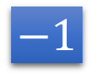



Maxout
ReLU is a special cases of Maxout
Learnable activation function [Ian J. Goodfellow, ICML’13]
+
neuron
+
$$5$$
$$1$$
Input
Max
$$7$$
Max
$$2$$
+
$$7$$
+
$$2$$
+
$$−1$$
+
$$4$$
Max
$$1$$
Max
$$4$$
+
$$1$$
+
$$3$$
You can have more than 2 elements in a group.
Notes:
How to train? Latter
2013
Ian J. Goodfellow goodfeli@iro.umontreal.ca David Warde-Farley wardefar@iro.umontreal.ca Mehdi Mirza mirzamom@iro.umontreal.ca Aaron Courville aaron.courville@umontreal.ca Yoshua Bengio

Slide 16
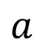

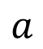
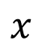
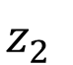

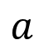
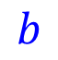
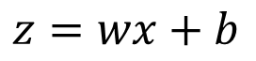
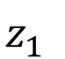
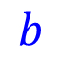
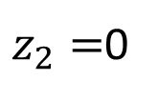

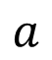
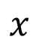

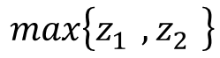
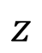
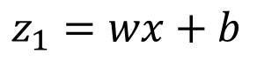
Maxout
ReLU is a special cases of Maxout
+
$$z_{1}^{}$$
$$z$$
ReLU
Input
$$w$$
$$a$$
Input
$$w$$
Max
$$b$$
$$a$$
$$0$$
+
$$z_{2}^{}$$
$$max\left\{z_{1}^{},z_{2}^{}\right\}$$
$$b$$
$$0$$
$$a$$
$$a$$
$$z=wx+b$$
$$z_{1}=wx+b$$
$$x$$
$$x$$
$z_{2}=$0

Slide 17
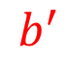

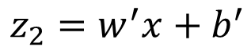
Maxout
More than ReLU
+
$$z_{1}^{}$$
$$z$$
ReLU
Input
$$w$$
$$a$$
Input
$$w$$
Max
$$b$$
$$a$$
+
$$z_{2}^{}$$
$$w^{′}$$
$$max\left\{z_{1}^{},z_{2}^{}\right\}$$
$$b$$
$$b^{′}$$
Learnable Activation Function
$$a$$
$$a$$
$$z=wx+b$$
$$z_{1}=wx+b$$
$$x$$
$$x$$
$$z_{2}=w^{′}x+b^{′}$$

Slide 18
Maxout
Learnable activation function [Ian J. Goodfellow, ICML’13]
Activation function in maxout network can be any piecewise linear convex function
How many pieces depending on how many elements in a group
2 elements in a group
3 elements in a group
Notes:
3,4,5

Slide 19
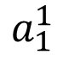
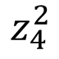
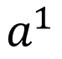













Maxout - Training
Given a training data x, we know which z would be the max
+
$$z_{1}^{1}$$
+
$$z_{1}^{2}$$
Input
Max
$$a_{1}^{1}$$
Max
$$a_{1}^{2}$$
+
$$z_{2}^{1}$$
+
$$z_{2}^{2}$$
$$max\left\{z_{1}^{1},z_{2}^{1}\right\}$$
+
$$z_{3}^{1}$$
+
$$z_{3}^{2}$$
Max
$$a_{2}^{1}$$
Max
$$a_{2}^{2}$$
$$x$$
+
$$z_{4}^{1}$$
$$a^{1}$$
+
$$z_{4}^{2}$$
$$a^{2}$$

Slide 20
Maxout - Training
Given a training data x, we know which z would be the max
Train this thin and linear network
+
$$z_{1}^{1}$$
+
$$z_{1}^{2}$$
Input
$$a_{1}^{1}$$
$$a_{1}^{2}$$
+
$$z_{2}^{1}$$
+
$$z_{2}^{2}$$
+
$$z_{3}^{1}$$
+
$$z_{3}^{2}$$
$$x$$
$$a_{2}^{1}$$
$$a_{2}^{2}$$
+
$$z_{4}^{1}$$
$$a^{1}$$
+
$$z_{4}^{2}$$
$$a^{2}$$
Different thin and linear network for different examples

Slide 21

SoftPlus （y=ln（1+e^{x}））

Slide 22



SoftMax

Slide 23


Soft Sign：

Slide 24


Keras
Notes:
Theno: Universite de Montr ´ eal
Yoshua Bengio

Slide 25
Keras
Step 3.1: Configuration
SGD, RMSprop, Adagrad, Adadelta, Adam, Adamax, Nadam
Step 3.2: Find the optimal network parameters
Training data
(Images)
Labels
(digits)
In the following slides
Notes:
Theno: Universite de Montr ´ eal
Yoshua Bengio

Slide 26


Keras
Step 3.2: Find the optimal network parameters
numpy array
numpy array
28 x 28
=784
……
10
……
Number of training examples
Number of training examples
https://www.tensorflow.org/versions/r0.8/tutorials/mnist/beginners/index.html
Notes:
Theno: Universite de Montr ´ eal
Yoshua Bengio

Slide 27














Mini-batch
We do not really minimize total loss!
Randomly initialize network parameters
x¹
NN
y¹
Pick the 1st batch
$${\hat{y}}^{1}$$
$$l^{1}$$
$$L′=l^{1}+l^{31}+⋯$$
Mini-batch
NN
x³¹
y³¹
$${\hat{y}}^{31}$$
Update parameters once
$$l^{31}$$
Pick the 2nd batch
……
$$L′′=l^{2}+l^{16}+⋯$$
Update parameters once
x²
NN
y²
$${\hat{y}}^{2}$$
$$l^{2}$$
…
Until all mini-batches have been picked
Mini-batch
x¹⁶
NN
y¹⁶
$${\hat{y}}^{16}$$
$$l^{16}$$
one epoch
……
Repeat the above process
Notes:
Each time we update paramters, we have different target -> 不安
Shuffle data, and repeat above process

Slide 28






Mini-batch
Batch size influences both speed and performance. You have to tune it.
Pick the 1st batch
x¹
NN
y¹
$${\hat{y}}^{1}$$
$$L′=l^{1}+l^{31}+⋯$$
$$l^{1}$$
Mini-batch
NN
Update parameters once
x³¹
y³¹
$${\hat{y}}^{31}$$
$$l^{31}$$
Pick the 2nd batch
……
$$L′′=l^{2}+l^{16}+⋯$$
100 examples in a mini-batch
Update parameters once
Batch size = 1
…
Until all mini-batches have been picked
Stochastic gradient descent
Repeat 20 times
one epoch
Notes:
Let’s try it.

Slide 29


Speed
Very large batch size can yield worse performance
Smaller batch size means more updates in one epoch
E.g. 50000 examples
batch size = 1, 50000 updates in one epoch
batch size = 10, 5000 updates in one epoch
166s
1 epoch
17s
10 epoch
166s
Batch size = 1 and 10, update the same amount of times in the same period.
Batch size = 10 is more stable, converge faster
17s
GTX 980 on MNIST with 50000 training examples

Slide 30


Speed - Matrix Operation
……
y₁
W¹
W²
W^{L}
……
y₂
b¹
b²
b^{L}
……
……
……
……
……
x
a¹
a²
y
……
y_{M}
y
x
$$=f\left( \right)$$
Forward pass
(Backward pass is similar)
W^{L}
…
W²
W¹
x
b¹
b²
…
b^{L}
+
+
+
$$σ\left( \right)$$
$$=σ\left( \right)$$
$$σ\left( \right)$$
Notes:
Draw it?

Slide 31











Speed - Matrix Operation
Why mini-batch is faster than stochastic gradient descent?
Stochastic Gradient Descent
$$z^{1}$$
=
$$W^{1}$$
$$x$$
$$z^{1}$$
=
$$W^{1}$$
$$x$$
……
Mini-batch
matrix
Practically, which one is faster?
$$z^{1}$$
$$z^{1}$$
=
$$W^{1}$$
$$x$$
$$x$$

Slide 32



Keras
Save and load models
http://keras.io/getting-started/faq/#how-can-i-save-a-keras-model
How to use the neural network (testing):
case 1:
case 2:
Notes:
Scalar test loss (if the model has a single output and no metrics) or list of scalars (if the model has multiple outputs and/or metrics). The attributemodel.metrics_names will give you the display labels for the scalar outputs.

Slide 33
Convolutional Neural Network

Slide 34










Why CNN for Image?
[Zeiler, M. D., ECCV 2014]
……
……
……
……
……
……
Represented as pixels
……
The most basic classifiers
Use 1st layer as module to build classifiers
Use 2nd layer as module ……
Can the network be simplified by considering the properties of images?

Slide 35


Why CNN for Image
Some patterns are much smaller than the whole image
A neuron does not have to see the whole image to discover the pattern.
Connecting to small region with less parameters
“beak” detector

Slide 36


Why CNN for Image
The same patterns appear in different regions.
“upper-left beak” detector
Do almost the same thing
They can use the same set of parameters.
“middle beak” detector

Slide 37


Why CNN for Image
Subsampling the pixels will not change the object
bird
bird
subsampling
We can subsample the pixels to make image smaller
Less parameters for the network to process the image

Slide 38

The whole CNN
cat dog ……
Convolution
Max Pooling
Can repeat many times
Fully Connected Feedforward network
Convolution
Max Pooling
Flatten

Slide 39
The whole CNN
Property 1
Some patterns are much smaller than the whole image
Convolution
Property 2
Max Pooling
The same patterns appear in different regions.
Can repeat many times
Property 3
Convolution
Subsampling the pixels will not change the object
Max Pooling
Flatten

Slide 40
The whole CNN
cat dog ……
Convolution
Max Pooling
Can repeat many times
Fully Connected Feedforward network
Convolution
Max Pooling
Flatten

Slide 41
CNN – Convolution
Those are the network parameters to be learned.
1 | -1 | -1
-1 | 1 | -1
-1 | -1 | 1
1 | 0 | 0 | 0 | 0 | 1
0 | 1 | 0 | 0 | 1 | 0
0 | 0 | 1 | 1 | 0 | 0
1 | 0 | 0 | 0 | 1 | 0
0 | 1 | 0 | 0 | 1 | 0
0 | 0 | 1 | 0 | 1 | 0
Filter 1
Matrix
-1 | 1 | -1
-1 | 1 | -1
-1 | 1 | -1
Filter 2
Matrix
……
6 x 6 image
Each filter detects a small pattern (3 x 3).
Property 1

Slide 42
CNN – Convolution
1 | -1 | -1
-1 | 1 | -1
-1 | -1 | 1
Filter 1
stride=1
1 | 0 | 0 | 0 | 0 | 1
0 | 1 | 0 | 0 | 1 | 0
0 | 0 | 1 | 1 | 0 | 0
1 | 0 | 0 | 0 | 1 | 0
0 | 1 | 0 | 0 | 1 | 0
0 | 0 | 1 | 0 | 1 | 0
3
-1
6 x 6 image

Slide 43
CNN – Convolution
1 | -1 | -1
-1 | 1 | -1
-1 | -1 | 1
Filter 1
If stride=2
1 | 0 | 0 | 0 | 0 | 1
0 | 1 | 0 | 0 | 1 | 0
0 | 0 | 1 | 1 | 0 | 0
1 | 0 | 0 | 0 | 1 | 0
0 | 1 | 0 | 0 | 1 | 0
0 | 0 | 1 | 0 | 1 | 0
3
-3
We set stride=1 below
6 x 6 image

Slide 44
CNN – Convolution
1 | -1 | -1
-1 | 1 | -1
-1 | -1 | 1
Filter 1
stride=1
1 | 0 | 0 | 0 | 0 | 1
0 | 1 | 0 | 0 | 1 | 0
0 | 0 | 1 | 1 | 0 | 0
1 | 0 | 0 | 0 | 1 | 0
0 | 1 | 0 | 0 | 1 | 0
0 | 0 | 1 | 0 | 1 | 0
3
-1
-3
-1
-3
1
0
-3
-3
-3
0
1
3
-2
-2
-1
6 x 6 image
Property 2

Slide 45
CNN – Convolution
-1 | 1 | -1
-1 | 1 | -1
-1 | 1 | -1
Filter 2
stride=1
Do the same process for every filter
1 | 0 | 0 | 0 | 0 | 1
0 | 1 | 0 | 0 | 1 | 0
0 | 0 | 1 | 1 | 0 | 0
1 | 0 | 0 | 0 | 1 | 0
0 | 1 | 0 | 0 | 1 | 0
0 | 0 | 1 | 0 | 1 | 0
3
-1
-3
-1
-1
-1
-1
-1
-3
1
0
-3
-1
-1
-2
1
Feature
Map
-3
-3
0
1
-1
-1
-2
1
3
-2
-2
-1
6 x 6 image
-1
0
-4
3
4 x 4 image

Slide 46

CNN – Colorful image
1 | -1 | -1
-1 | 1 | -1
-1 | -1 | 1
-1 | 1 | -1
-1 | 1 | -1
-1 | 1 | -1
1 | -1 | -1
-1 | 1 | -1
-1 | -1 | 1
-1 | 1 | -1
-1 | 1 | -1
-1 | 1 | -1
1 | -1 | -1
-1 | 1 | -1
-1 | -1 | 1
-1 | 1 | -1
-1 | 1 | -1
-1 | 1 | -1
Filter 1
Filter 2
Colorful image
1 | 0 | 0 | 0 | 0 | 1
0 | 1 | 0 | 0 | 1 | 0
0 | 0 | 1 | 1 | 0 | 0
1 | 0 | 0 | 0 | 1 | 0
0 | 1 | 0 | 0 | 1 | 0
0 | 0 | 1 | 0 | 1 | 0
1 | 0 | 0 | 0 | 0 | 1
0 | 1 | 0 | 0 | 1 | 0
0 | 0 | 1 | 1 | 0 | 0
1 | 0 | 0 | 0 | 1 | 0
0 | 1 | 0 | 0 | 1 | 0
0 | 0 | 1 | 0 | 1 | 0
1 | 0 | 0 | 0 | 0 | 1
0 | 1 | 0 | 0 | 1 | 0
0 | 0 | 1 | 1 | 0 | 0
1 | 0 | 0 | 0 | 1 | 0
0 | 1 | 0 | 0 | 1 | 0
0 | 0 | 1 | 0 | 1 | 0

Slide 47

Convolution v.s. Fully Connected
1 | 0 | 0 | 0 | 0 | 1
0 | 1 | 0 | 0 | 1 | 0
0 | 0 | 1 | 1 | 0 | 0
1 | 0 | 0 | 0 | 1 | 0
0 | 1 | 0 | 0 | 1 | 0
0 | 0 | 1 | 0 | 1 | 0
1 | -1 | -1
-1 | 1 | -1
-1 | -1 | 1
-1 | 1 | -1
-1 | 1 | -1
-1 | 1 | -1
convolution
image
1 | 0 | 0 | 0 | 0 | 1
0 | 1 | 0 | 0 | 1 | 0
0 | 0 | 1 | 1 | 0 | 0
1 | 0 | 0 | 0 | 1 | 0
0 | 1 | 0 | 0 | 1 | 0
0 | 0 | 1 | 0 | 1 | 0
Fully-connected
……
……

Slide 48

1 | -1 | -1
-1 | 1 | -1
-1 | -1 | 1
1:
1
Filter 1
2:
0
3:
0
3
4:
0
1 | 0 | 0 | 0 | 0 | 1
0 | 1 | 0 | 0 | 1 | 0
0 | 0 | 1 | 1 | 0 | 0
1 | 0 | 0 | 0 | 1 | 0
0 | 1 | 0 | 0 | 1 | 0
0 | 0 | 1 | 0 | 1 | 0
…
7:
0
8:
1
9:
0
10:
0
…
13:
0
6 x 6 image
14:
0
Less parameters!
15:
Only connect to 9 input, not fully connected
1
16:
1
…

Slide 49

1 | -1 | -1
-1 | 1 | -1
-1 | -1 | 1
1:
1
Filter 1
2:
0
3:
0
3
4:
0
1 | 0 | 0 | 0 | 0 | 1
0 | 1 | 0 | 0 | 1 | 0
0 | 0 | 1 | 1 | 0 | 0
1 | 0 | 0 | 0 | 1 | 0
0 | 1 | 0 | 0 | 1 | 0
0 | 0 | 1 | 0 | 1 | 0
…
7:
0
8:
1
-1
9:
0
10:
0
…
13:
0
6 x 6 image
14:
0
Less parameters!
15:
1
16:
1
Shared weights
Even less parameters!
…

Slide 50
The whole CNN
cat dog ……
Convolution
Max Pooling
Can repeat many times
Fully Connected Feedforward network
Convolution
Max Pooling
Flatten

Slide 51
CNN – Max Pooling
1 | -1 | -1
-1 | 1 | -1
-1 | -1 | 1
-1 | 1 | -1
-1 | 1 | -1
-1 | 1 | -1
Filter 1
Filter 2
3
-1
-3
-1
-1
-1
-1
-1
-3
1
0
-3
-1
-1
-2
1
-3
-3
0
1
-1
-1
-2
1
3
-2
-2
-1
-1
0
-4
3

Slide 52
CNN – Max Pooling
New image
but smaller
1 | 0 | 0 | 0 | 0 | 1
0 | 1 | 0 | 0 | 1 | 0
0 | 0 | 1 | 1 | 0 | 0
1 | 0 | 0 | 0 | 1 | 0
0 | 1 | 0 | 0 | 1 | 0
0 | 0 | 1 | 0 | 1 | 0
Conv
3
0
-1
1
Max
Pooling
3
1
0
3
2 x 2 image
6 x 6 image
Each filter
is a channel

Slide 53
The whole CNN
3
0
-1
1
Convolution
3
1
0
3
Max Pooling
Can repeat many times
A new image
Convolution
Smaller than the original image
The number of the channel is the number of filters
Max Pooling

Slide 54
The whole CNN
cat dog ……
Convolution
Max Pooling
A new image
Fully Connected Feedforward network
Convolution
Max Pooling
A new image
Flatten

Slide 55
Flatten
3
0
1
3
0
-1
1
3
3
1
-1
0
3
Flatten
1
Fully Connected Feedforward network
0
3

Slide 56

CNN in Keras
Only modified the network structure and input format (vector -> 3-D tensor)
input
Convolution
1 | -1 | -1
-1 | 1 | -1
-1 | -1 | 1
-1 | 1 | -1
-1 | 1 | -1
-1 | 1 | -1
There are 25 3x3 filters.
……
Max Pooling
Input_shape = ( 1 , 28 , 28 )
1: black/weight, 3: RGB
28 x 28 pixels
Convolution
3
-1
3
Max Pooling
-3
1

Slide 57
CNN in Keras
Only modified the network structure and input format (vector -> 3-D tensor)
input
1 x 28 x 28
Convolution
How many parameters for each filter?
9
25 x 26 x 26
Max Pooling
25 x 13 x 13
Convolution
How many parameters for each filter?
225
50 x 11 x 11
Max Pooling
50 x 5 x 5

Slide 58

CNN in Keras
Only modified the network structure and input format (vector -> 3-D tensor)
input
1 x 28 x 28
output
Convolution
25 x 26 x 26
Fully Connected Feedforward network
Max Pooling
25 x 13 x 13
Convolution
50 x 11 x 11
Max Pooling
1250
50 x 5 x 5
Flatten

Slide 59



What does CNN learn?
The output of the k-th filter is a 11 x 11 matrix.
x
input
Degree of the activation of the k-th filter:
$$a^{k}=\sum_{i=1}^{11}{\sum_{j=1}^{11}{a_{ij}^{k}}}$$
25 3x3 filters
Convolution
$$x^{∗}=arg\max_{x}{a^{k}}$$
(gradient ascent)
11
Max Pooling
3
-1
……
-1
50 3x3 filters
$$a_{ij}^{k}$$
Convolution
-3
1
……
-3
11
50 x 11 x 11
……
……
……
Max Pooling
3
-2
……
-1

Slide 60

What does CNN learn?
The output of the k-th filter is a 11 x 11 matrix.
input
Degree of the activation of the k-th filter:
$$a^{k}=\sum_{i=1}^{11}{\sum_{j=1}^{11}{a_{ij}^{k}}}$$
25 3x3 filters
Convolution
$$x^{∗}=arg\max_{x}{a^{k}}$$
(gradient ascent)
Max Pooling
50 3x3 filters
Convolution
50 x 11 x 11
Max Pooling
For each filter

Slide 61




What does CNN learn?
input
Find an image maximizing the output of neuron:
Convolution
$$x^{∗}=arg\max_{x}{a^{j}}$$
Max Pooling
Convolution
Max Pooling
flatten
Each figure corresponds to a neuron
$$a_{j}$$

Slide 62



What does CNN learn?
input
$$x^{∗}=arg\max_{x}{y^{i}}$$
Can we see digits?
Convolution
Max Pooling
0
1
2
Convolution
Max Pooling
3
4
5
flatten
6
7
8
Deep Neural Networks are Easily Fooled
https://www.youtube.com/watch?v=M2IebCN9Ht4
$$y_{i}$$

Slide 63



What does CNN learn?
Over all pixel values
$$x^{∗}=arg\max_{x}\left(y^{i}−\sum_{i,j}{\left|x_{ij}\right|}\right)$$
$$x^{∗}=arg\max_{x}{y^{i}}$$
0
1
2
0
1
2
3
4
5
3
4
5
6
7
8
6
7
8

Slide 64



Deep Dream
CNN
Modify image
Given a photo, machine adds what it sees ……
$$\left[\begin{aligned}3.9 \\ −1.5 \\ 2.3 \\ ⋮\end{aligned}\right]$$
CNN exaggerates what it sees
http://deepdreamgenerator.com/
Notes:
http://speech.ee.ntu.edu.tw/dokuwiki/lib/exe/fetch.php?media=speech:meeting:paper_report:paper_report_2015-08-12.pdf

Slide 65

Deep Dream
Given a photo, machine adds what it sees ……
http://deepdreamgenerator.com/

Slide 66

Deep Style
Given a photo, make its style like famous paintings
https://dreamscopeapp.com/

Slide 67

Deep Style
Given a photo, make its style like famous paintings
https://dreamscopeapp.com/

Slide 68

Deep Style
CNN
CNN
A Neural Algorithm of Artistic Style
https://arxiv.org/abs/1508.06576
content
style
CNN
?

Slide 69

More Application: Playing Go
Network
Next move
(19 x 19 positions)
19 x 19 matrix (image)
19 x 19 vector
19 x 19 vector
Fully-connected feedforward network can be used
Black: 1
white: -1
none: 0
But CNN performs much better.

Slide 70




More Application: Playing Go
record of previous plays
Training:
黑: 5之五
白: 天元
黑: 五之5 …
Target:
“天元” = 1
else = 0
CNN
Target:
“五之 5” = 1
else = 0
CNN

Slide 71


Why CNN for playing Go?
Some patterns are much smaller than the whole image
The same patterns appear in different regions.
Alpha Go uses 5 x 5 for first layer

Slide 72

Why CNN for playing Go?
Subsampling the pixels will not change the object
Max Pooling
How to explain this???
Alpha Go does not use Max Pooling ……
Notes:
Very good example for desing your network

Slide 73

More Application: Speech
The filters move in the frequency direction.
CNN
Frequency
Image
Time
Spectrogram

Slide 74

More Application: Text
?
Source of image: http://citeseerx.ist.psu.edu/viewdoc/download?doi=10.1.1.703.6858&rep=rep1&type=pdf

Slide 75
总结
卷积网络VS全连接网络
局部连接；
参数共享；
降采样。

Slide 76
典型CNN
LeNet-5
AlexNet
VGGNet
GoogLeNet
ResNet

Slide 77


LeNet-5
Gradient Based Learning Applied To Document Recognition - Y. Lecun, L. Bottou, Y. Bengio, P. Haffner; 1998

Slide 78

LeNet-5
8层网络：输入层（INPUT）：32x32； 卷积层（Convolutions,C1）：6个5x5
池化层（Subsampling，S2）：2x2的最大池化
卷积层（C3）： 池化层（Subsampling，S4）；
卷积层（C5）；全连接层（F6）；
输出层（径向基层）

Slide 79
LeNet-5
输入层（1）：32x32
背景值: -0.1，前景值 : 1.175。这使得平均输入大约为0，而方差大约为1

Slide 80

LeNet-5
卷积层（C1）：6个5x5
连接数：(5x5+1)x28x28x6 = 122304
激活函数：线性函数
参数：（5x5+1)x6 = 156个

Slide 81

LeNet-5
池化层（S2）：2x2的池化，
选择框的数据求和再取平均值然后在乘上一个权值和加上一个偏置值，
激活函数：sigmod函数
参数：2x6=12

Slide 82

LeNet-5
卷积层（C3）：16个5*5卷积核，厚度有6个3, 9个4， 1个6
目的：特征不对称
连接数： (5x5x3+1)x10x10x6+(5x5x4+1)x10x10x9+(5x5x6+1)x10x10 = 45600+90900+15100=151600
权值数： (5x5x3+1)x6 + (5x5x4+1)x9 + 5x5x6+1 = 456 + 909+151 = 1516

Slide 83
LeNet-5
池化层（S4）：同S2一样，2x2的池化，
选择框的数据求和再取平均值然后在乘上一个权值和加上一个偏置值，
激活函数：sigmod函数
参数：2x6=12

Slide 84
LeNet-5
卷积层（C5）： 120个5*5卷积核，厚度为16
连接数为：（5x5x16+1)x120=48120,
参数：48120个待训练权值

Slide 85
LeNet-5
全连接层（F6）；84个神经元，激活函数：tanh
连接数：(120+1)x84 = 10164
参数：(120+1)x84 = 10164

Slide 86



LeNet-5
输出层（径向基层）：十个神经元，
基于径向基神经网络的输出层

Slide 87

LeNet-5
8层网络：输入层（INPUT）：32x32； 卷积层（Convolutions,C1）：6个5x5
池化层（Subsampling，S2）：2x2的最大池化
卷积层（C3）： 池化层（Subsampling，S4）；
卷积层（C5）；全连接层（F6）；
输出层（径向基层）

Slide 88

AlexNet
ImageNet Classification with Deep Convolutional Neural Networks - Alex Krizhevsky, Ilya Sutskever, Geoffrey E. Hinton; 2012
2012年， ImageNet LSVRC的冠军，准确率远超第二名（top5错误率为15.3%，第二名为26.2%）
采用技术：
（1）非线性激活函数：ReLU
（2）防止过拟合的方法：Dropout，数据扩充（Data augmentation）
（3）多GPU实现，LRN归一化层

Slide 89


AlexNet
非线性激活函数：ReLU

Slide 90
AlexNet
防止过拟合的方法：数据扩充（Data augmentation）
（1）随机裁剪，对256×256的图片随机裁剪到224×224，然后水平翻转，样本数量增加了（（256-224）^2）×2=2048倍
（2）测试时，对左上、右上、左下、右下、中间分别5次裁剪，然后翻转，共10个裁剪，并对结果求平均。避免过拟合
（3）对RGB空间做PCA变换，然后对主成分做（0, 0.1）的高斯扰动，其错误率下降了1%

Slide 91
AlexNet
防止过拟合的方法：数据扩充（Data augmentation）
（1）随机裁剪，对256×256的图片随机裁剪到224×224，然后水平翻转，样本数量增加了（（256-224）^2）×2=2048倍
（2）测试时，对左上、右上、左下、右下、中间分别5次裁剪，然后翻转，共10个裁剪，并对结果求平均。避免过拟合
（3）对RGB空间做PCA变换，然后对主成分做（0, 0.1）的高斯扰动，其错误率下降了1%

Slide 92

AlexNet
重叠池化 (Overlapping Pooling)
池化大小: 3×3，池化步长: 2，出现重叠
重叠池化可以避免过拟合，降低了0.3%的Top-5错误率

Slide 93

AlexNet
局部归一化（Local Response Normalization，简称LRN）
“侧抑制”：被激活的神经元抑制相邻神经元
增加泛化能力,降低了1.2%的Top-5错误率

Slide 94

AlexNet
网络结构
共8层，5层卷积，3层全连接，输出层1000路的softmax层
采用两个GPU并行训练：结构图由上下两部分组成，一个GPU运行图上方，另一个运行图下方，两个GPU只在特定的层交换信息。

Slide 95

AlexNet
第一层
输入：227×227×3
卷积核：96个11×11×3，每组48个
步长：4
特征图： (227-11)/4+1=55
ReLU
池化：尺寸为3×3，步长为2，则池化后图像的为 (55-3)/2+1=27
归一化：5×5，大小：27×27×96，每组48个像素层

Slide 96

AlexNet

Slide 97
AlexNet
第二层
输入：27×27×96
Padding：填充2
卷积核：256个5×5×48，每组分128个
步长：1
特征图： 27×27×128
ReLU
池化：尺寸为3×3，步长为2，则池化后图像的尺寸为（ 57-3)/2+1=13
归一化：5×5，
输出：2组13×13×128

Slide 98

AlexNet

Slide 99

AlexNet
第三层
输入： (13+1+1)×(13+1+1)×128
卷积核：2组192个3×3×256，
步长：1
特征图：13×13×384
ReLU
输出： ：13×13×384

Slide 100
AlexNet
第四层（类似第三层）
输入（13+1+1)×(13+1+1)×192
卷积核：192个3×3×192，
步长：1
特征图：13×13×384
ReLU
输出： ：2组13×13×192

Slide 101
AlexNet
第五层
输入：
2组 (13+1+1)×(13+1+1)×192
卷积核：2组128个3×3×192，
步长：1
特征图：2组13×13×256
ReLU
池化：3×3，步长为2
输出： ：两组6×6×128

Slide 102

AlexNet
第六层
输入：6×6×256
2组 (13+1+1)×(13+1+1)×192
卷积核：4096个6×6×256，
特征图： 4096
ReLU
Dropout
输出： 4096

Slide 103

AlexNet
第七层
输入：4096
ReLU
Dropout
输出： 4096

Slide 104

AlexNet
第八层 （输出层）
输入：4096
softmax
输出： 1000

Slide 105


AlexNet
创新：

Slide 106

VGGNet
Very Deep Convolutional Networks For Large Scale Image Recognition - Karen Simonyan and Andrew Zisserman; 2015
ILSVRC2014第二名（第一名是GoogLeNet）和定位项目的第一名
6~19层深的卷积神经网络
140 million parameters

Slide 107

VGGNet
5层卷积层、3层全连接层、softmax输出层构成，层与层之间使用max-pooling（最大化池）分开，所有隐层的激活单元都采用ReLU函数

Slide 108
VGGNet
（1）结构简洁：5层卷积层、3层全连接层、softmax输出层构成，层与层之间使用max-pooling（最大化池）分开，所有隐层的激活单元都采用ReLU函数
（2）小卷积核和多卷积子层：使用多个多层层小卷积核（3x3）的卷积层
（3）池化核：2x2
（4）通道数多：第一层的通道数为64，后面每层都进行了翻倍，最多到512个通道

Slide 109
VGGNet
（5）层数更深、特征图更宽 卷积核扩大通道数、模型架构更深，控制计算量的增加规模
（6）全连接转卷积
网络测试阶段将训练阶段的三个全连接替换为三个1*1的卷积层，可以接收任意宽或高为的输入图像

Slide 110

VGGNet
三个全连接替换为三个1*1的卷积层，可以接收任意宽或高为的输入图像

Slide 111

VGGNet

Slide 112
VGGNet
1、输入224x224x3，64个3x3的卷积核作两次卷积+ReLU，卷积后224x224x64 2、作max pooling，池化单元2x2，池化后112x112x64 3、128个3x3的卷积核作两次卷积+ReLU，尺寸变为112x112x128 4、作2x2的max pooling，尺寸为56x56x128 5、经256个3x3的卷积核三次卷积+ReLU，尺寸变为56x56x256 6、作2x2的max pooling，尺寸为28x28x256 7、经512个3x3的卷积核作三次卷积+ReLU，尺寸为28x28x512 8、作2x2的max pooling，尺寸为14x14x512 9、经512个3x3的卷积核作三次卷积+ReLU，尺寸变为14x14x512 10、作2x2的max pooling，尺寸为7x7x512 11、与两层1x1x4096，一层1x1x1000进行全连接+ReLU（共三层） 12、通过softmax输出1000个预测结果

Slide 113

VGGNet
1、通过增加深度能有效地提升性能； 2、最佳模型：VGG16，从头到尾只有3x3卷积与2x2池化，简洁优美； 3、卷积可代替全连接，可适应各种尺寸的图片

Slide 114
GoogleNet
Going Deeper with Convolutions - Christian Szegedy et al.; 2015
ILSVRC2014第一名
22层
500万参数，约为VGG三分之一

Slide 115

GoogleNet
22 layers
Efficient “Inception” module
No FC layers
Only 5 million parameters!
ILSVRC’14 classification winner (6.7% top 5 error)
[Szegedy et al., 2014]
Notes:
22 שכבות
הם השתמשו במה שהם קראו לו הinception module
והם השתמשו במודל הזה מספר פעמים.
הם וויתרו על השכבות FC ובכך הורידו משמעותית את מספר הפרמטים. 5 מיליון במקום 60 מיליון.

Slide 116


GoogleNet-Inception
Inception V1
（1）多尺度的卷积核，池化，1*1卷积核降低维度
（2）增强网络的表现能力，

Slide 117

GoogleNet
“Inception module”: design a good local network topology (network within a network) and then stack these modules on top of each other
Filter concatenation
1x1 convolution
3x3 convolution
5x5 convolution
1x1 convolution
1x1 convolution
1x1 convolution
3x3 max pooling
Previous layer
Slide taken from Fei-Fei & Justin Johnson & Serena Yeung. Lecture 9.
[Szegedy et al., 2014]
Notes:
אז כאן אנחנו רואים את המבנה הזה שהם קוראים לו inception module
נחשוב על זה כרשת בתוך רשת ואז לוקחים את התת רשת ומערימים אותן אחת על השניה.
עכשיו ננסה להבין את המבנה של התת רשת הזו

Slide 118
GoogleNet
Naïve Inception Model
Apply parallel filter operations on the input :
Multiple receptive field sizes for convolution (1x1, 3x3, 5x5)
Pooling operation (3x3)
Concatenate all filter outputs together depth-wise
Filter concatenation
1x1 convolution
3x3 convolution
5x5 convolution
3x3 max pooling
Previous layer
Slide taken from Fei-Fei & Justin Johnson & Serena Yeung. Lecture 9.
[Szegedy et al., 2014]
Notes:
בCNN מסורתי, בכל שכבה אנחנו בעצם בוחרים אם להפעיל שכבת conv או שכבת pooling ואם בחרנו בשכבת conv אז אנחנו צריכים גם לבחור את גודל הפילטר. המודול הזה מאפשר להפעיל את הפעולות האלה במקביל וזה בעצם הרעיון של המודל הנאיבי.
הרעיון הוא להפעיל פילטרים בגדלים שונים על הinput שמגיע מהשכבה הקודמת במקביל, יחד עם pooling ובסוף לשרשר את התוצאות שאנחנו מקבלים מכל הפילטרים.
השרשור הוא בעומק
הסיבה היא שאנחנו לא בהכרח יודעים מה יעבוד הכי טוב. אז ככה אנחנו נותנים לרשת ללמוד את הפרמטרים כפי שהיא רוצה ועם השילובים שהיא רוצה, ואנחנו לא צריכים לבחור.
נשים לב שהשתמשנו בpadding פה גם עבור הmax pooling כי רצינו לשמר את אות מימדים

Slide 119
GoogleNet
What’s the problem with this? High computational complexity
Filter concatenation
1x1 convolution
3x3 convolution
5x5 convolution
3x3 max pooling
Previous layer
Slide taken from Fei-Fei & Justin Johnson & Serena Yeung. Lecture 9.
[Szegedy et al., 2014]
Notes:
Basically, at each layer of a traditional ConvNet, you have to make a choice of whether to have a pooling operation or a conv operation (there is also the choice of filter size). What an Inception module allows you to do is perform all of these operations in parallel. In fact, this was exactly the “naïve” idea that the authors came up with.

Slide 120
GoogleNet
Output volume sizes:
1x1 conv, 128: 28x28x128
3x3 conv, 192: 28x28x192
5x5 conv, 96: 28x28x96
3x3 pool: 28x28x256
What is output size after filter concatenation?
28x28x(128+192+96+256) = 28x28x672
Example:
Filter concatenation
1x1 conv 128
3x3 conv 192
5x5 conv 96
3x3 max pooling
Previous layer 28x28x256
Slide taken from Fei-Fei & Justin Johnson & Serena Yeung. Lecture 9.
[Szegedy et al., 2014]
Notes:
אנחנו יודעים שהpooling layer משמר לנו את העומק, כלומר את מספר הchannels ובגלל בחירת הpadding, גם שימרנו את המימדים המרחביים.
עשינו פה padding שמשמר את המימד המרחבי
נשים לב שהשרשור הוא בעומק
שמרנו על מימדים מרחביים אבל גדלנו בטירוך בעומק

Slide 121
GoogleNet
Number of convolution operations:
1x1 conv, 128: 28x28x128x1x1x256
3x3 conv, 192: 28x28x192x3x3x256
5x5 conv, 96: 28x28x96x5x5x256
Total: 854M ops
Filter concatenation
1x1 conv 128
3x3 conv 192
5x5 conv 96
3x3 max pooling
Previous layer 28x28x256
Slide taken from Fei-Fei & Justin Johnson & Serena Yeung. Lecture 9.
[Szegedy et al., 2014]
Notes:
החישוב פה הוא למשל עם פילטר 1x1 כשהinput הוא בעומק 256 אב הפעולה היא 1x1x256 בdot product אבל יש לנו 28x28 מיקומים שונים ו128 פילטרים שונים.
אלה דוגמאות שדומות למספרים שנראה באחת השכבות.
במודל עצמו יש פרמטרים שונים בכל הופעה של המודל בשכבה אחרת.

Slide 122
GoogleNet
Very expensive compute!
Pooling layer also preserves feature depth, which means total depth after concatenation can only grow at every layer.
Filter concatenation
1x1 conv 128
3x3 conv 192
5x5 conv 96
3x3 max pooling
Previous layer 28x28x256
Slide taken from Fei-Fei & Justin Johnson & Serena Yeung. Lecture 9.
[Szegedy et al., 2014]

Slide 123
GoogleNet
Solution: “bottleneck” layers that use 1x1 convolutions to reduce feature depth (from previous hour).
Filter concatenation
1x1 convolution
3x3 convolution
5x5 convolution
3x3 max pooling
Previous layer
Slide taken from Fei-Fei & Justin Johnson & Serena Yeung. Lecture 9.
[Szegedy et al., 2014]
Notes:
Basically, at each layer of a traditional ConvNet, you have to make a choice of whether to have a pooling operation or a conv operation (there is also the choice of filter size). What an Inception module allows you to do is perform all of these operations in parallel. In fact, this was exactly the “naïve” idea that the authors came up with.

Slide 124
GoogleNet
Solution: “bottleneck” layers that use 1x1 convolutions to reduce feature depth (from previous hour).
Filter concatenation
1x1 convolution
3x3 convolution
5x5 convolution
1x1 convolution
1x1 convolution
1x1 convolution
3x3 max pooling
Previous layer
Slide taken from Fei-Fei & Justin Johnson & Serena Yeung. Lecture 9.
[Szegedy et al., 2014]
Notes:
הפתרון הוא על ידי הוספת שכבות שנקראות bottleneck שמטרתן להטיל את הfeature maps למימד נמוך יותר לפני שכבות הקונבולוציה שהן השכבות היקרות.
הוספנו את הקונבולוציה 1x1 הזאת במקומות שזה עוזר לנו להוריד את מספר החישובים.

Slide 125
Number of convolution operations: 1x1 conv, 64: 28x28x64x1x1x256 1x1 conv, 64: 28x28x64x1x1x256 1x1 conv, 128: 28x28x128x1x1x256 3x3 conv, 192: 28x28x192x3x3x64 5x5 conv, 96: 28x28x96x5x5x264 1x1 conv, 64: 28x28x64x1x1x256 Total: 353M ops
Compared to 854M ops for naive version
Filter concatenation
1x1 conv 128
3x3 conv 192
5x5 conv 96
1x1 conv 64
1x1 conv 64
1x1 conv 64
3x3 max pooling
Previous layer 28x28x256
Slide taken from Fei-Fei & Justin Johnson & Serena Yeung. Lecture 9.
[Szegedy et al., 2014]
Notes:
עכשיו נראה איך התוספת הזאת משפיעה על הדוגמה שראינו. כשאנחנו נוסיפים את ה64 פילטרים של 1x1.
אתם בטח שואלים את עצמכם אם הקטנת הייצוג הזו פגעה לנו בביצועים-
אז ראו שאם משתמשים בשכבת הbottleneck הזאת בצורה הגיונית אז זה מאפשר לנו ממש להקטין את הייצוג ולחסוך חישובים, מבלי לפגוע בביצועים.

Slide 126
GoogleNet
Details/Retrospectives :
Deeper networks, with computational efficiency
22 layers
Efficient “Inception” module
No FC layers
12x less params than AlexNet
ILSVRC’14 classification winner (6.7% top 5 error)
Slide taken from Fei-Fei & Justin Johnson & Serena Yeung. Lecture 9.
[Szegedy et al., 2014]
Notes:
עכשיו נראה את המבנה הכולל של הרשת כולה
מתחילים מלמטה מכמה שכבות של של conv-pool ואחרי זה יש את המודלים אחד על גבי השני.
אפשר לראות שבסוף לא שמו שכבות FC אלא יש classifier. ככה הם הפחיתו במספר הפרמטרים
לשלוחות האלה שיוצאים, קוראים auxilary classification outputs והם גם סוג של מיני רשת הבנוי מ avg pooling-> 1x1 conv -> FC ->FC -> softmax
זה גם עוזר לרשת להמנע מoverfitting
הsoftmax שלוחות האלה הוא גם ל1000 קטגוריות של imagenet אז זה נותן לנו קלספיקציה מוקדמת יותר ברשת. זוזה גם עוזר לנו לעשות קלספיקציה
סהכ 22 שכבות עם משקלים
חשוב לזכור שמי שפיתח את זה, זה גוגל שיש להם הרבה קלסטרים רצים והרבה משאבים כדי להתנסות ולראות מה עובד.
לכל שכבה פה יש משקלים נפרדים
הבעיה ברשתות עמוקות זה שהגרדיאנט דועך כשאנחנו מתקדמים בתוך הרשת ולכן זה עוזר להוסיף גרדיאנט בתהליך הbackpropagation.

Slide 127
GoogleNet
Introduced the idea that CNN layers didn’t always have to be stacked up sequentially. Coming up with the Inception module, the authors showed that a creative structuring of layers can lead to improved performance and computationally efficiency.
[Szegedy et al., 2014]

Slide 128

ImageNet Large Scale Visual Recognition Challenge (ILSVRC) winners
Slide taken from Fei-Fei & Justin Johnson & Serena Yeung. Lecture 9.
Notes:
הזוכה משנת 2015 –
כאן המודל הוא כבר ממש עמוק עם 152 שכבות

Slide 129
ResNet
Deep Residual Learning for Image Recognition - Kaiming He, Xiangyu Zhang, Shaoqing Ren, Jian Sun; 2015
Extremely deep network – 152 layers
Deeper neural networks are more difficult to train.
Deep networks suffer from vanishing and exploding gradients.
Present a residual learning framework to ease the training of networks that are substantially deeper than those used previously.
[He et al., 2015]
Notes:
הזוכה משנת 2015 –
כאן המודל הוא כבר ממש עמוק עם 152 שכבות
הבעיה היא בעצם שברשתות עמוקות, הגרדיאנטים נוטים לגדול מידי או לקטון מידי - להתפוצץ או לדעוך.
במאמר ציינו את הבעיה של training ברשתות עמוקות מאוד. בשקופיות הבאות נראה יותר לעומק את הבעיה הזו.

Slide 130

ResNet
ILSVRC’15 classification winner (3.57% top 5 error, humans generally hover around a 5-10% error rate) Swept all classification and detection competitions in ILSVRC’15 and COCO’15!
Slide taken from Fei-Fei & Justin Johnson & Serena Yeung. Lecture 9.
[He et al., 2015]
Notes:
הרשת הזו היא שוב משמעותית יותר טובה מכל אלה שקדמו לה אבל נשים לב שהשיפור בדיוק הוא לא באותו יחס לגידול במספר שכבות.

Slide 131

ResNet
What happens when we continue stacking deeper layers on a convolutional neural network?
56-layer model performs worse on both training and test error
-> The deeper model performs worse (not caused by overfitting)!
Slide taken from Fei-Fei & Justin Johnson & Serena Yeung. Lecture 9.
[He et al., 2015]
Notes:
השאלה היא, מה קורה כשאנחנו מוסיפים עוד ועוד שכבות לרשת, האם הרשת הולכת ומשתפרת?
מסתבר שהתשובה היא לא
אנחנו רואים כאן השוואה בין מודל של 56 שכבות למודל של 20 שכבות
אנחנו רואים שבtest error הרשת עם ה56 שכבות מראה שגיאה גבוהה יותר מהרשת עם ה20 שכבות.
מה שמוזר זה שגם בtraining error אנחנו גם רואים שהמודל עם ה56 שכבות נותן תוצאות פחות טובות וזה מראה לנו שזה בעצם לא כתוצאה מoverfitting של רשת עמוקה עם הרבה פרמטרין אלא זה בגלל משהו אחר. כי בoverfitting אנחנו מקבלים דווקא training error טוב.

Slide 132
ResNet
Hypothesis: The problem is an optimization problem. Very deep networks are harder to optimize.
Solution: Use network layers to fit residual mapping instead of directly trying to fit a desired underlying mapping.
We will use skip connections allowing us to take the activation from one layer and feed it into another layer, much deeper into the network.
Use layers to fit residual F(x) = H(x) – x instead of H(x) directly
Slide taken from Fei-Fei & Justin Johnson & Serena Yeung. Lecture 9.
[He et al., 2015]
Notes:
ההיפותזה שהציעו במאמר היא שפשוט קשה יותר לעשות אופטמיזציה לרשתות עמוקות יותר.
הם טענו שרשתות עמוקות צריכות לתת תוצאות טובות לפחות כמו רשתות פחות עמוקות
וההוכחה לזה היא שלוקחים את השכבות שכבר למדנו ברשת רדודה, ומוסיפים על גביהן שכבות נוספות של identity mapping וכן התוצאות צריכות להיות זהות. אבל בפועל, לרשתות מאוד עמוקוץ, קשה לבחור פרמטרים שנותנים אפילו את הidentitfy function ולכן זה נותן תוצאה גרועה יותר במקום טובה יותר.
אז זה המוטיבציה
ועכשיו הם רוצים לעזור למודל ללמוד אופטמיזציה יותר טובה.

Slide 133

ResNet
Residual Block Input x goes through conv-relu-conv series and gives us F(x). That result is then added to the original input x. Let’s call that H(x) = F(x) + x. In traditional CNNs, H(x) would just be equal to F(x). So, instead of just computing that transformation (straight from x to F(x)), we’re computing the term that we have to add, F(x), to the input, x.
[He et al., 2015]
Notes:
הרעיון הוא שx שלנו עובר ברצף של conv-relu-conv וזה נותן לנו תוצאה F(x).
את התוצאה הזו אנחנו אחר כך מוסיפים לx וקוראים לזה H(x) = F(x) + x
ברשת מסורתית H(x) = F(x) אז במקום לחשב את הטרנספורמציה, אנחנו מחשבים את הביטוי שצריך להוסיף לinput שלנו x. כך שהמודול הזה מחשב את הדלתא או את השינוי שיש להוסיף לx כדי לקבל ייצוג אחר. כותבי המאמר בעצם טוענים שקל יותר לאפטם את הresidual mapping הזה מאשר את המיפוי המקורי.
בעצם מעבירים את הInput כidentity
המימדים הם זהים או שיש דרכים לעשות Padding כדי להגיע לאותו מימד בעומק
מחשבים F(x)=H(x)-x במקום את H(x) ישירות. F(x) זה הresidual.
ההיפותזה שציינו קודם, מראה שאולי אפילו משהו שהוא מאוד קרוב לidentity mapping היה נותן לנו תוצאות טובות ולכן הפתרון הזה מתאים להיפותזה.

Slide 134














ResNet
$$a^{[l+1]}$$
$$a^{[l]}$$
$$a^{[l+2]}$$
Short cut/ skip connection
$$a^{[l]}$$
$$Linear$$
$$ReLU$$
$$Linear$$
$$ReLU$$
$$a^{[l+2]}$$
$$a^{[l+1]}$$
$$z^{[l+1]}{=W}^{[l+1]}a^{[l]}+b^{[l+1]}$$
$$z^{[l+2]}= W^{[l+2]}a^{[l+1]}+b^{[l+2]}$$
$$a^{[l+1]}=g(z^{[l+1]})$$
$$a^{[l+2]}=g(z^{[l+2]})$$
$a^{[l+2]}=g\left(z^{\left[l+2\right]}+a^{\left[l\right]}\right)={g(W}^{[l+2]}a^{[l+1]}+b^{[l+2]}+a^{\left[l\right]}$)
[He et al., 2015]
Notes:
A – זה הactivation
נשים לב שה injection של a הוא אחרי השלב הלינארי אבל לפני הReLU.
אם נניח W נהיה 0 וגם b לצורך העניין בגלל weight decay
ואז g(a) שווה לa מכיוון שrelu נותן Identity במקרה החיובי.
אז ראינו שהidentity function זה משהו שקל לresidual block ללמוד
לכן זה לא יפגע ביכולת של הרשת שלנו להצליח כי מקסימום נקבל את הidentity function
ויותר מזה, זה יכול רק לעזור לרשת שלנו להצליח יותר וללמוד משהו טוב ויעיל בהוספת השכבות האלה.

Slide 135
ResNet
Full ResNet architecture:
Stack residual blocks
Every residual block has two 3x3 conv layers
Periodically, double # of filters and downsample spatially using stride 2 (in each dimension)
Additional conv layer at the beginning
No FC layers at the end (only FC 1000 to output classes)
Slide taken from Fei-Fei & Justin Johnson & Serena Yeung. Lecture 9.
[He et al., 2015]
Notes:
המבנה הוא של הרבה residual blocks אחד על גבי השני.
כל בלוק בנוי מ2 שכבות conv 3x3
מידי פעם מכפילים את מספר הפילטרים ועושים downsampling עם stride 2.
בסוף יש pooling
והכנסה לקלספיקציה
המבנה פשוט ואלגנטי

Slide 136
ResNet
Total depths of 34, 50, 101, or 152 layers for ImageNet
For deeper networks (ResNet-50+), use “bottleneck” layer to improve efficiency (similar to GoogLeNet)
Slide taken from Fei-Fei & Justin Johnson & Serena Yeung. Lecture 9.
[He et al., 2015]
Notes:
בניסיונות שבהם עשו יותר מ50 שכבות, אז גם השתמשו בקונספט של bottleneck layers כדי לשפר יעילות על ידי הפחתת המימד של העומק לפני שעושים את הקונבולוציות

Slide 137
ResNet
Experimental Results:
Able to train very deep networks without degrading
Deeper networks now achieve lower training errors as expected
Slide taken from Fei-Fei & Justin Johnson & Serena Yeung. Lecture 9.
[He et al., 2015]

Slide 138
ResNet
The best CNN architecture that we currently have and is a great innovation for the idea of residual learning.
Even better than human performance!
[He et al., 2015]

Slide 139

Object detection

Slide 140

CNN的扩展：R-CNN
基本思想：首先采用非深度的方法，在图像中提取
可能是物体的图形块，然后利用深度学习算法根据这些图
像块，判断属性和物体的位置
Selective Search：先把完全不可能是物体的图像块去
除，只剩2000左右的图像块放到深度网络⾥判断。

Slide 141
CNN的扩展：R-CNN
特点：速度慢，重复计算多，wrapping引起图像变形。
如何解决resize问题？

Slide 142

SPPNET
spatial pyramid pooling:⾦金字塔
式池化
优点：保留了图像的特征，没有变形
速度：有进步，⽐RCNN速度提升了24-102倍。
缺点：与RCNN一样，训练过程是多阶段过程

Slide 143

Fast-R-CNN
1.训练过程通过运⽤用多任务损失，实现单步骤完成；
2.在训练过程中所有层都可以得到更新；
速度：⽐SPPNet训练时间快了3倍，测试时间快了10倍。
缺点：proposal的计算瓶颈依然存在

Slide 144

Faster-R-CNN
1.在网络中建立候选框的搜索
2.速度：⽐RCNN提升两三百倍

Slide 145

Faster-R-CNN
一种网络，
四个损失函数

Slide 146
其他方法
Mask R-CNN
SSD (Single Shot MultiBox Defender)
YOLO (You Only Look Once)

Slide 147
To learn more ……
The methods of visualization in these slides
https://blog.keras.io/how-convolutional-neural-networks-see-the-world.html
More about visualization
http://cs231n.github.io/understanding-cnn/
Very cool CNN visualization toolkit
http://yosinski.com/deepvis
http://scs.ryerson.ca/~aharley/vis/conv/
The 9 Deep Learning Papers You Need To Know About
https://adeshpande3.github.io/adeshpande3.github.io/The-9-Deep-Learning-Papers-You-Need-To-Know-About.html

Slide 148
To learn more ……
How to let machine draw an image
PixelRNN
https://arxiv.org/abs/1601.06759
Variation Autoencoder (VAE)
https://arxiv.org/abs/1312.6114
Generative Adversarial Network (GAN)
http://arxiv.org/abs/1406.2661

